Slide 1

COMSATS University Islamabad, Wah Campus
Department of Computer Science
LECTURE # 32 (20 online class)
SUBJECT NAME: Automata Theory
TOPIC: Pushdown Automata

Slide 2
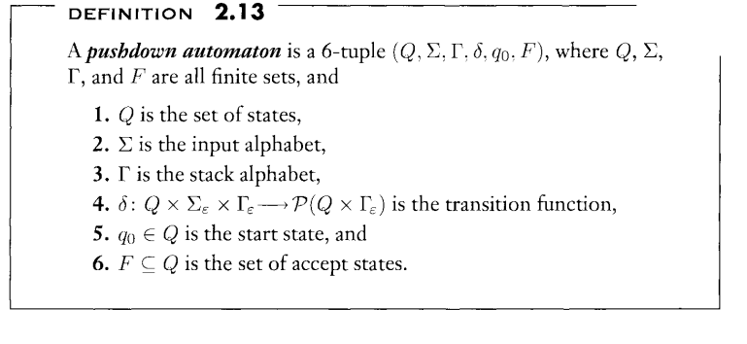

Theory of Automata CS312
Pushdown Automata

Slide 3
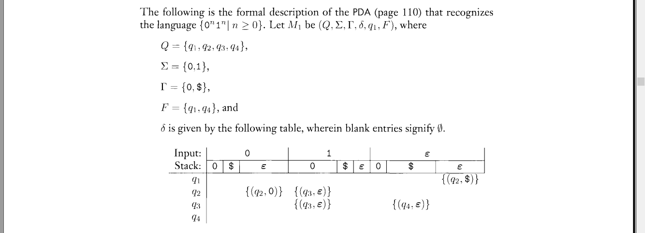
Pushdown Automata

Slide 4

Pushdown Automata

Slide 5
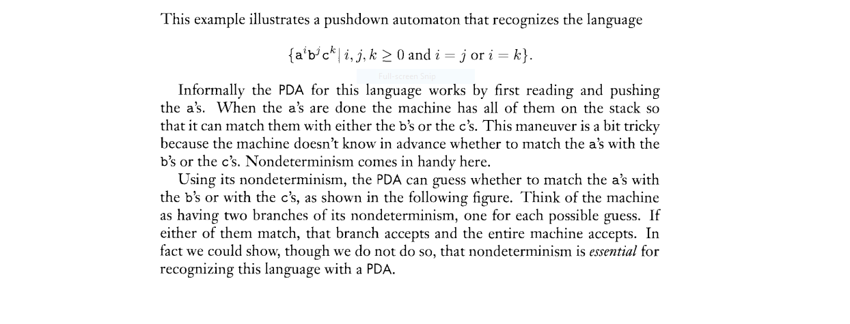
Pushdown Automata

Slide 6
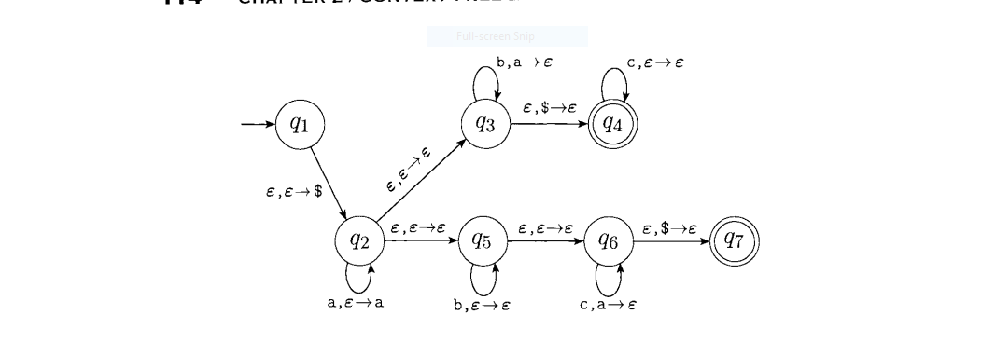
PDA

